Slide 1
2022 ProTech Vendor Engagement - A Look Ahead
23 February 2022

Slide 2
Agenda
CPARS
Procurement Forecast
Market Research Refresh
ProTech Updates
Intro to Acquisition Innovation
Introductions from SB Office and NWS
Q&A Session

Slide 3
CPARS
Evaluation Areas:
Quality
Management
Schedule
Small Business Subcontracting (if applicable)

Slide 4
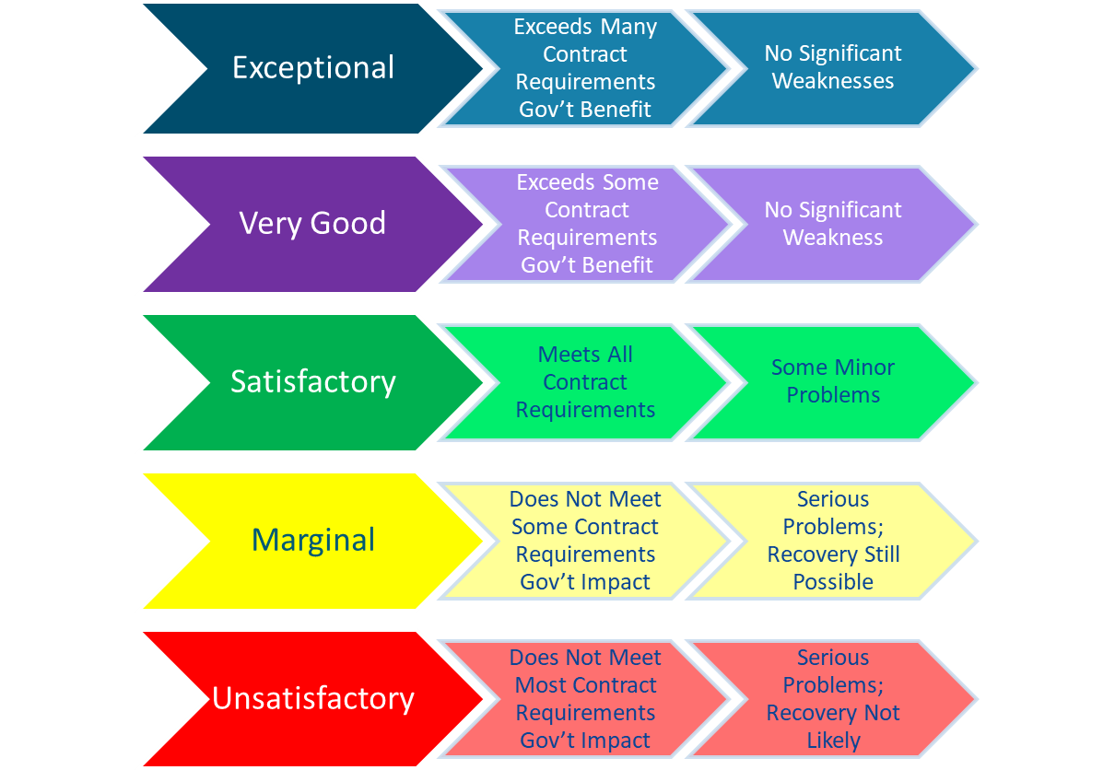
CPARS

Slide 5
CPARS
Evaluation Criteria:
Contractual Requirements:
Monthly Contract Progress Reports (IDIQ and TO Level)
SASH Training (due 01 Mar)
Large Businesses: Small Business Subcontracting Plan
Additional Criteria:
Participation in Virtual Engagement Events
Participation in RFIs
Participation in Market Research Refresh
Regular Communication

Slide 6
Forecast
How is the procurement forecast developed?
How does a requirement end up on on the forecast?
How long does a requirement stay on the forecast?
What about draft PWS/SOW?

Slide 7
Market Research Refresh
Participation in the Market Research Refresh (MRR) is an important engagement event for PMO as it provides awareness of new or enhanced corporate technical capabilities and partnerships that have emerged. As a result, the information provided on increased capabilities contributes to the most recent and relevant market research support during the acquisition planning phase of a procurement action.
Next MRR in May/Jun

Slide 8
ProTech Updates
Our new website
https://www.noaa.gov/acquisition-grants/protech
Individual Vendor Engagement Event - April/May
Virtual Vendor Engagement Event with NWS programs - October/November

Slide 9
Guests from Small Business Office and NWS
NOAA Small Business Office - Mr. Lucas Payne
National Weather Service - Ms. Olga Brown-Leigh

Slide 10
Q & A Session

