Slide 1
NOAA Acquisition & Grants Office (AGO)
Professional And Technical (ProTech) Services Oceans Domain Post-Award Conference
February 14, 2019
Marcelle Loveday, SSAD Director

Slide 2
Department of Commerce
Strategic Plan
ACCELERATE AMERICAN LEADERSHIP
Expand Commercial Space Activities
Advance Innovation
Strengthen Intellectual Property Protection
FULFILL CONSTITUTIONAL REQUIREMENTS AND SUPPORT ECONOMIC ACTIVITY
Conduct a Complete and Accurate Decennial Census
Provide Accurate Data to Support Economic Activity
ENHANCE JOB CREATION
Increase Aquaculture Production
Reduce and Streamline Regulations
Strengthen Domestic Commerce and the U.S. Industrial Base
Increase U.S. Exports
Increase Inward Investment Into the United States
DELIVER CUSTOMER-CENTRIC SERVICE EXCELLENCE
Engage Commerce Employees
Accelerate IT Modernization
Consolidate Functions for Cost Savings
STRENGTHEN U.S. ECONOMIC AND NATIONAL SECURITY
Enforce the Nation’s Trade Laws and Security Laws
Enhance the Nation’s Cybersecurity
Reduce Extreme Weather Impacts
Deploy Public Safety Broadband

Slide 3
NOAA Primary Objectives
Lead the world in earth system observation and prediction to enhance the nation's economy
Minimize the impacts of severe weather by implementing Public Law 115-25 (Weather Research and Forecasting Innovation Act)
Increase the sustainable contributions to the nation's economy through fishery and marine resource management, mapping, exploration, observation, and prediction

Slide 4
AGO Goals
Balance Mission and Fiduciary Duty
Support the NOAA Mission
Protect the public interest
Seek efficiency and effectiveness
Operate with integrity and transparency
Management
Move from service delivery to core competency
Provide Line/Staff Offices with support throughout the Financial Assistance lifecycle
Build industry partnerships through strategic sourcing & consolidation
Expand acquisition beyond formation to management

Slide 5
AGO Organization Chart
AGO Director’s Office
Jeffrey Thomas, Director
Kelly Mabe, Deputy Director
David G. Price, Chief of Staff
Ombudsman / Risk Manager
Rafael Roman
Small Business
Jeffrey Hale Natalie Colbert
Policy & Oversight Division
W. Chad Wagner
Staff Services Management Division
David G. Price
Grants Management Division
Arlene Simpson Porter
Strategic Sourcing Acquisition Division
Marcelle Loveday
Satellite & Information Acquisition Division
Rafael Rivera
Eastern Acquisition Division
Jack Salmon
Western Acquisition Division
Chad Hepp

Slide 6
NOAA’s Strategic Sourcing Goals
Improve outcomes
Increase use of performance-based techniques
Accelerate & deepen understanding
Establish partnerships
Streamline processes
Reduce administrative time
Notes:
© Copyright PresentationGO.com

Slide 7
Build an Industrial Base of Partners Small – Medium – Large Organizations
Capability Model
Business Model
Best Value Tradeoff
HIGHER
FLUFF
Veneered
Credentialed
Episodic
TALENT
Niche
Scarce
Valuable
HIGHER
HOSTAGE
Dominant
Protected Insulated
PARTNER
Client Focused
Enduring
Reciprocal
Cost
Profit
WASTELAND
Transactional
Short Term
Limited
COMMON
Efficient
Effective
Repeatable
VENDOR
Limited
Constrained
Alienated
Rapport less
SUPPLIER
Undifferentiated
Commercial
Staff Augmentation
LOWER
LOWER
LPTA
Competency
Competition
LOWER
HIGHER
LOWER
HIGHER
A Race to the Bottom Hurts Everyone
Margin Drives Investment, Recruitment, Retention, and Esprit de Corps
Partnership Thrives on Communication, Cooperation, and Duration

Slide 8
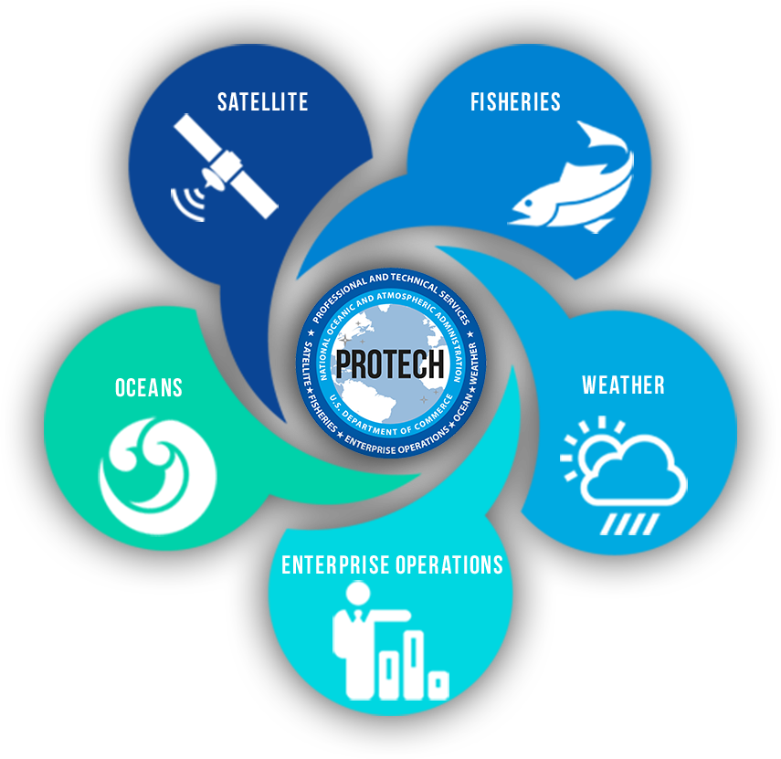
NOAA’s Strategic Sourcing Initiatives
NOAALink: NOAA-wide IT initiative
Core suite of Small Business IT services contracts
Period of Performance 9/2010 – 9/2020
Includes enterprise-wide contracts for commodity software and hardware products
ProTech: Domain-specific professional & technical services solution
Suite of IDIQ contracts, $3 Billion shared ceiling
Five year period of performance for most Domains
Satellite Domain – Awarded June 2017
Fisheries Domain – Awarded September 2018
Oceans Domain – Awarded February 2019
Weather Domain – Award anticipated Q3/4 FY19
Enterprise Operations Domain – new strategy Aug 2018

