Slide 1
An Introduction to Innovation in Acquisition
Acquisition and Grants Office (AGO)
Pierre Smith
Contracting Officer (Weather ACO/Satellite PCO)
NAIL Member
DOC Innovation Council Member
January, 2022

Slide 2
What Does “Innovation” Mean?
New ideas
Incremental changes
Underutilized techniques
Embracing managed risk
Breaking from the norm
"Why would we want to do this?”
Notes:
The word “Innovation” has been thrown around a lot over the past few years. I’m sure some of you may even be tired of hearing this “buzz word.” So I want to refocus on what we mean when we refer to innovation, and connect it to the changes we’re seeing in federal procurement across the country.
Innovation isn’t always “the next big thing.” More often, it is simply “change that adds value,” and these are some examples.
New Ideas
Transformational changes
Might be the next big thing
Thinking Outside the Box
Incremental Changes
Process improvement - removing an unnecessary obstacle
Thinking inside the box

Slide 3
Meeting Demands
Today’s fast-paced contracting environment requires the Government to have the ability to work in and around the FAR to provide innovative solutions to acquisition requirements.
Innovation is key to meeting the challenges and risks of a continuously evolving marketplace.
If we want to meet the demands of our mission more efficiently, innovation strategies must become a part of our future.

Slide 4
Best Mediums for Innovation
Task Order Competitions (FAR 16.505)
ProTech
NITAAC
8(a) STARS III
Call Order Competitions (FAR Part 8.4)
NMITS
GSA Schedules
Simplified Acquisition Procedures (FAR Part 13)
FAR Part 15 competitions do not lend themselves to certain techniques due to various policy or regulatory constraints

Slide 5
Commonly Used Techniques
Oral Presentations
Confidence Ratings
On-the-Spot Consensus Evaluation
Advisory Down-Selects
Highest Technically Rated Offeror with Reasonable Price (HTRO-RP)

Slide 6
Oral Presentations
See and hear their proposed solutions!
Avoids making the competition an essay writing contest
Greater confidence the company knows the technical requirement
Provides an opportunity for dialogue
Can substitute all or parts of a written proposal
Consensus evaluation immediately following each Offeror's oral presentation

Slide 7
Confidence Ratings
Adjectival ratings limit evaluators
*Only required for FAR Part 15*
Confidence Ratings provide greater flexibility and help streamline documentation
They give us a holistic sense that we have the most confidence in an Offeror
Not required to document strengths, deficiencies, significant weaknesses, and risks

Slide 8
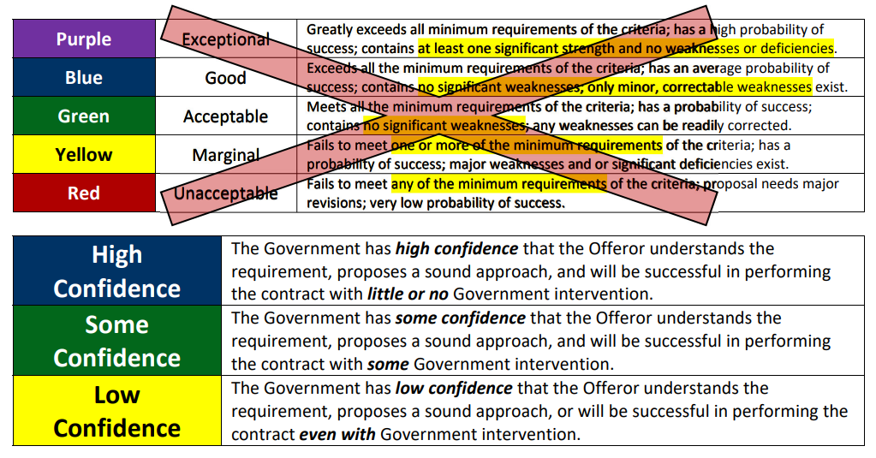
Confidence Ratings Descriptions

Slide 9
On-the-Spot Consensus Evaluation
The evaluation team reads the proposal (or attends the oral presentation) and then, as a group, evaluates the proposal and immediately documents the evaluation decision in real time before starting the evaluation of the next proposal
Document the decision, not the deliberations
Evaluate and arrive at consensus, and then document the rationale for the decision

Slide 10
Advisory Down-Select
When a large number of responses is anticipated in a competitive acquisition, let’s consider a phased evaluation
Down-selects:
Reduce cost and burden to industry
Reduce the amount of documentation for the government to review
Remove non-viable companies for a cleaner trade-off decision at the final phase
Reduce the number of debriefings and protests

Slide 11
Highest Technically Rated Offeror with Reasonable Price (HTRO-RP)
Allows award to the highest technically rated offer that is also found to have a reasonable price without using trade-offs between cost or price and technical
Price evaluation of only the highest ranked or rated offer proceeds next
If the Offeror's price is not determined to be fair and reasonable, the offer is rejected and the next highest ranked

Slide 12
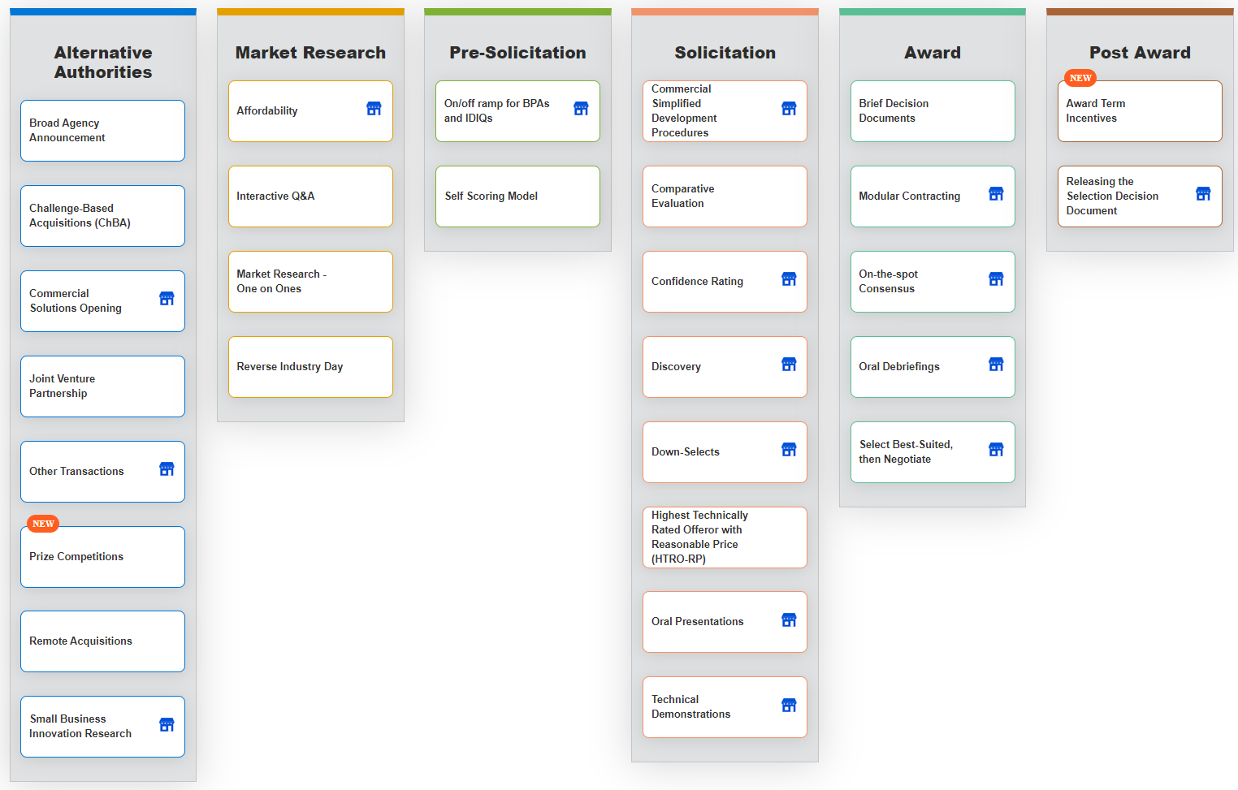
More Techniques!
www.fai.gov/periodic-table

Slide 13
Resources

Slide 14
Resources
NOAA Acquisition Innovation Lab (NAIL)
NAIL.innovation@noaa.gov
DOC “The Lab”
www.commerce.gov/oam/lab
DHS Procurement Innovation Lab (PIL)
https://www.dhs.gov/pil
FAI Periodic Table of Acquisition Innovations
www.fai.gov/periodic-table

Slide 15
Questions?
NOAA Points of Contact:
Pierre Smith
Weather Domain ACO/Satellite Domain (2.0) PCO
NAIL Member
pierre.s.smith@noaa.gov
NOAA Acquisition Innovation Lab (NAIL) NAIL.innovation@noaa.gov

